Slide 1

Welcome to our Spotify Data Analytics Workshop
Part 1 presented by Ezzard Bradford and Nicolas Tobon

Slide 2
Fair warning
Some of the music I listen to contains profanity in the titles so be weary of that
Keep an open mind about my music choice OK!
Ok let’s have fun now !

Slide 3
What will you learn from this workshop?
Working with json files and getting them into dataframes and other structures so data can be manipulated
Accessing, adding, and overall manipulating data frames
Configuring the API to retrieve more insights on the data
Visualizing your data in Tableau to gain insights and make conclusions

Slide 4
What is JSON?

Slide 5
JSON (JavaScript Object Notation) Basics
JSON is simply a lightweight format for data that is text-based, used to transfer data in a language independent way.
Language independent: Code for reading and writing JSON can be easily generated by programming languages
JSON naturally organizes data into a dictionary
Every {} signifies a JSON Object
Our Spotify data will come in JSON format so it is important to understand how to use it

Slide 6
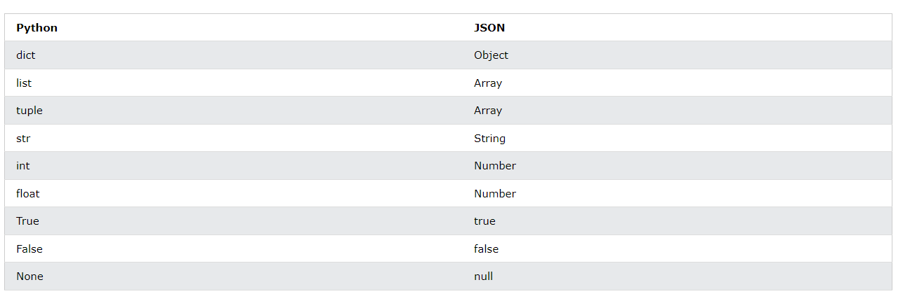
Python to JSON
JSON Object {}
JSON Array []

Slide 7
Pandas Dataframe Functions
pd.read_json(‘file_name.extension’)
Reads a JSON-formatted file and returns a pandas dataframe
pd.read_json(URL)
Valid URL schemes include http, ftp, s3, and file
Reads a JSON-formatted URL and returns a pandas dataframe
df.to_json(‘file_name.extension’)
Creates a JSON-formatted file from a pandas dataframe

Slide 8
What data does spotify actually show you ?
Spotify gives you various json files with personal data regarding the following
Playlist
Streaming History(audio, video, and podcasts)
Your Library
Search Queries
Follow
Payments and many more. Here’s a link for the full list of data you are given link

Slide 9
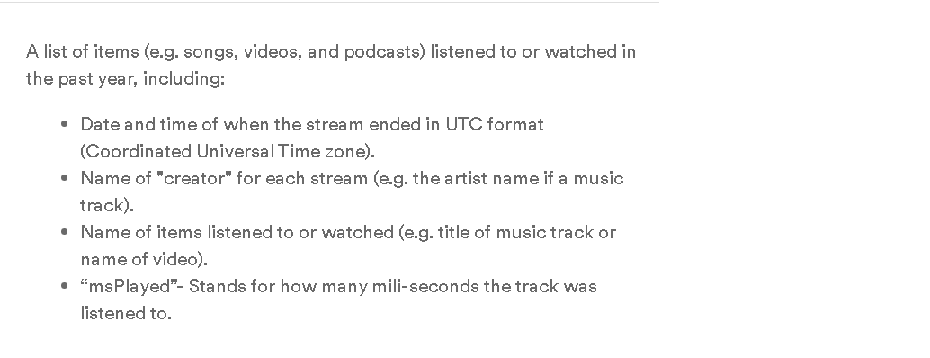
What Data are we concerned with?
We are concerned with our Streaming History Data

Slide 10
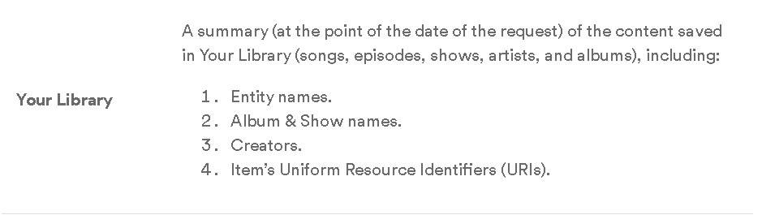
We are concerned with our library data

Slide 11
Let’s work with our data now

Slide 12
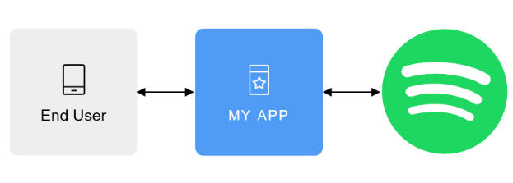
Accessing the API
An API (Application Programming Interface) is a regulated software that allows two applications to interact with each other
1) Your very-smart application
2) The desired resource you’re looking for

Slide 13
Authorization
Authorization refers to the process of granting a user or application access permissions to Spotify data and features. Spotify implements the OAuth 2.0 authorization framework:
End User corresponds to the Spotify user. The End User grants access to the protected resources (e.g. playlists, personal information, etc.)
My App is the client that requests access to the protected resources (e.g. a mobile or web app).
Server which hosts the protected resources and provides authentication and authorization via OAuth 2.0.

Slide 14
What determines how we are granted access? (Scopes)
There are various scopes
Scopes enable your application to access specific functionality (e.g. read a playlist, modify your library or just streaming) on behalf of a user. The set of scopes you set during the authorization, determines the access permissions that the user is asked to grant.

Slide 15
As the end user, how do we grant access?
The authorization process requires valid client credentials: a client ID and a client secret to grant access
These are basically attributes specific to your account that spotify verifies to authorize you.

Slide 16
How do we get these credentials? !
Go to this link: this will allow you to make your application
The credentials will be pivotal to accessing the api. We will go more in detail on their importance later

Slide 17
Ok how do we get authorized… Now what? What does that look like?
Once the authorization is granted, the authorization server issues an access token
The access token is used to make API calls on behalf the user

Slide 18
How do we make the access token#
We need to make a Post Request(i’ll explain this later)
The client credentials(client secret and client_id)
This verifies your account and tells spotify you give them consent to provide your data
The authentication URL: 'https://accounts.spotify.com/api/token'
This is where we will send our request to. Think of this as the link that breaks us into the API
We will format this information and then send a request out to spotify. We will demonstrate what this looks like. Spotify has documentation that is critical to follow to carry out this task. Let’s examine it

Slide 19
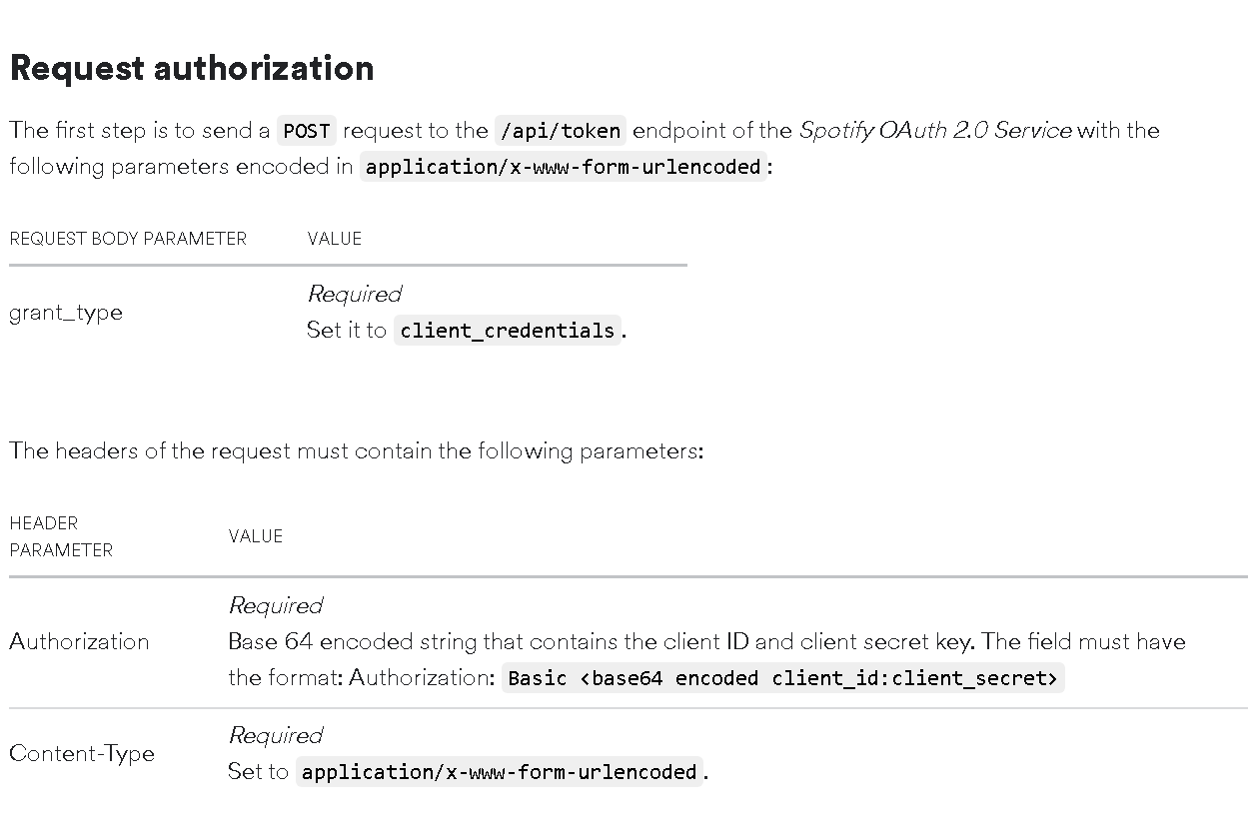

Slide 20
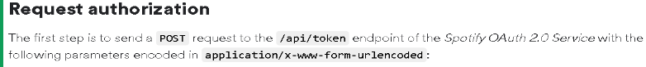
We have this nice documentation but how do we actually make sense of it?
Let’s break it down starting with the first important thing
What is a post requests and what is the /api/token/endpoint?

Slide 21
What is a Post request?
A request is a request to access an HTTP library
We can use requests.post() to make your request
Let’s take a look at the function and its parameters
That’s where the requests library comes in !

Slide 22
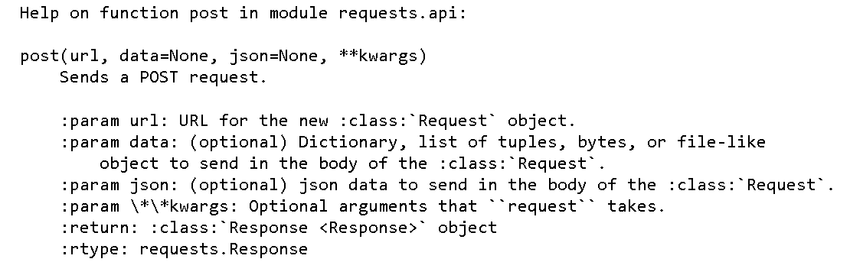
Deeper look at Request.post

Slide 23
Making sense of the functions parameters
Parameters it takes in that we are concerned with:
Url - this is just the authentication url
Data-? What’s this??
What are we returned?
A Response object.

Slide 24
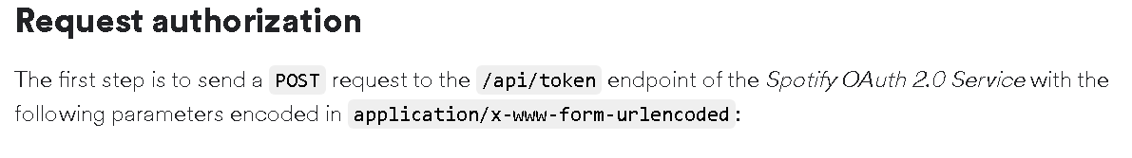
What’s the authentication url? All we have is the endpoint?

Slide 25
What is the endpoint?
There’s a base URL for receiving an access token
What is the base URL?
https://accounts.spotify.com
What is the endpoint?
/api/token
The end point is basically what we put at the end of the url to specify what we want

Slide 26
We have our endpoint so now we need our data
Full authentication url
https://accounts.spotify.com/api/token'
What is our data?

Slide 27
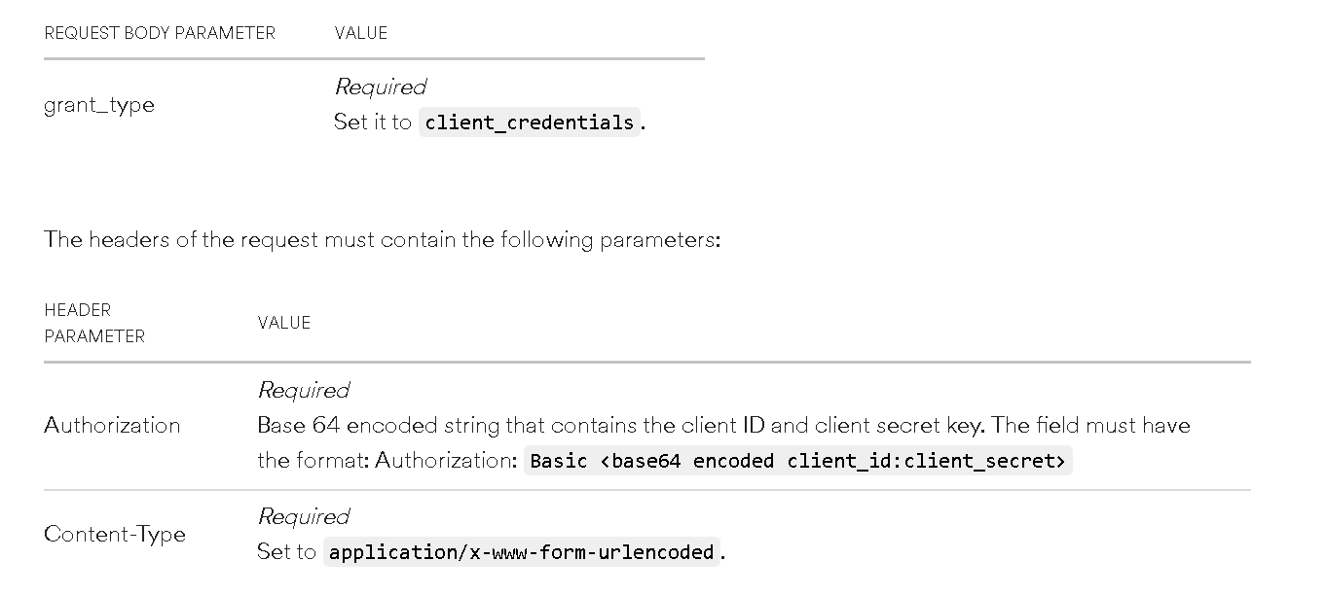
Let’s look at the data parameters on both the documentation and the function

Slide 28
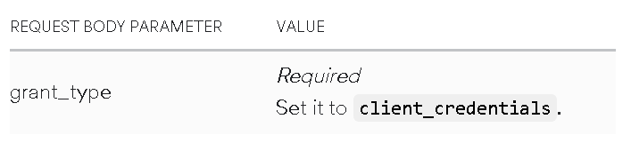
Let’s break it down. What’s the grant type?
We write this in a colon format
So like this

Slide 29
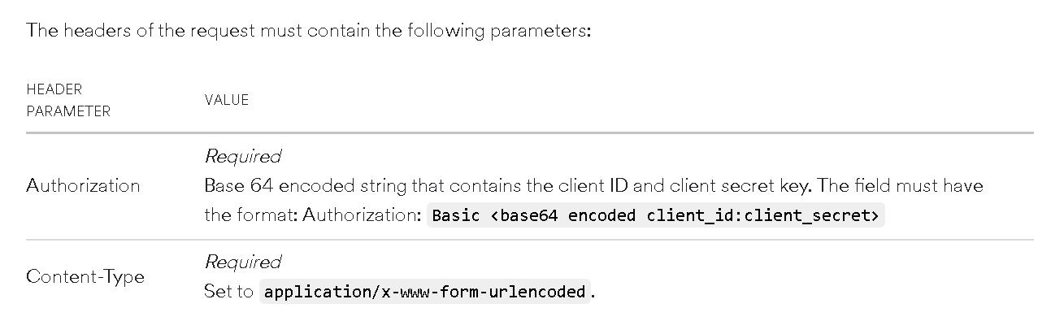
Ok we’re moving up what’s the headers?

Slide 30
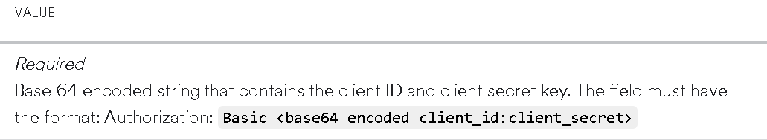
Well we know that the string is ‘authorization’:
But what is THIS?

Slide 31
Ok this documentation is hard to follow but there’s more than one way to get authorized
We can just pass in the grant type and then the client credentials we discussed earlier
We can follow through with the other method displayed in the documentation but it’s more involved
Luckily there is more than one way to skin a cat

Slide 32
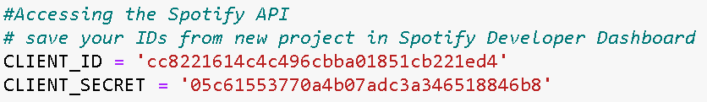
We need our client credentials (Remember from earlier?)

Slide 33
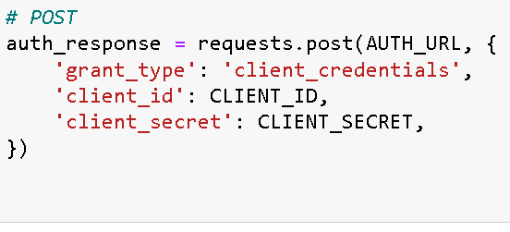
Let’s put it altogether now

Slide 34
Now we can send our post
Our post is the request that will be sent the spotify to be granted access to the API. Think of it as being sent to authentication url
Recall, we get this access by getting the access token which Spotify will prompt us as long as they can verify us through the post requests we send

Slide 35
Getting the access_token
Ok we did all this fancy stuff but what happened? What actually returned? What is python returning us?
Well let’s find out!

Slide 36
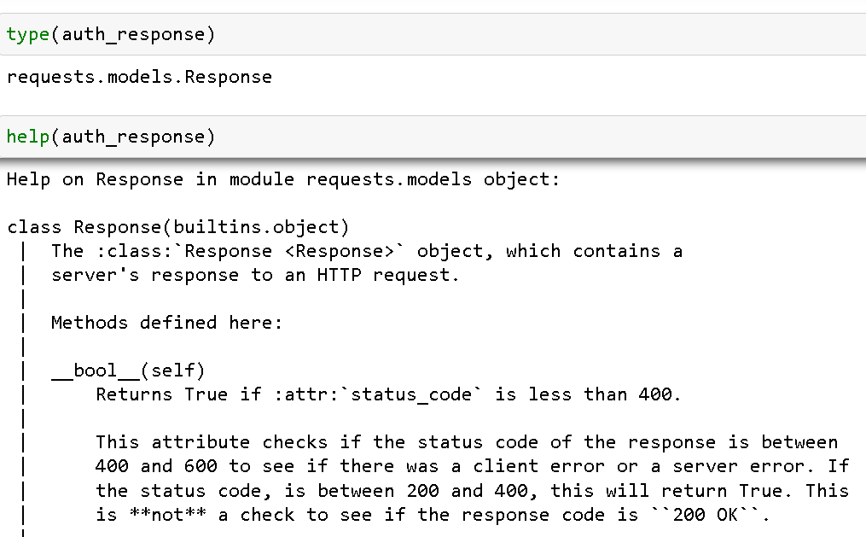

Slide 37
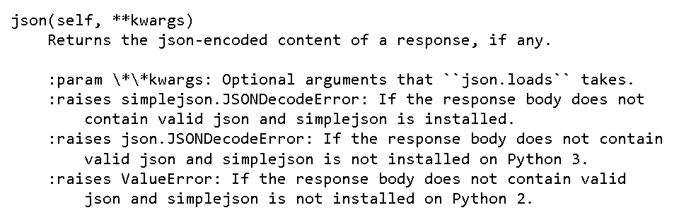
What can we do with this response object?
We can convert it to a json file

Slide 38
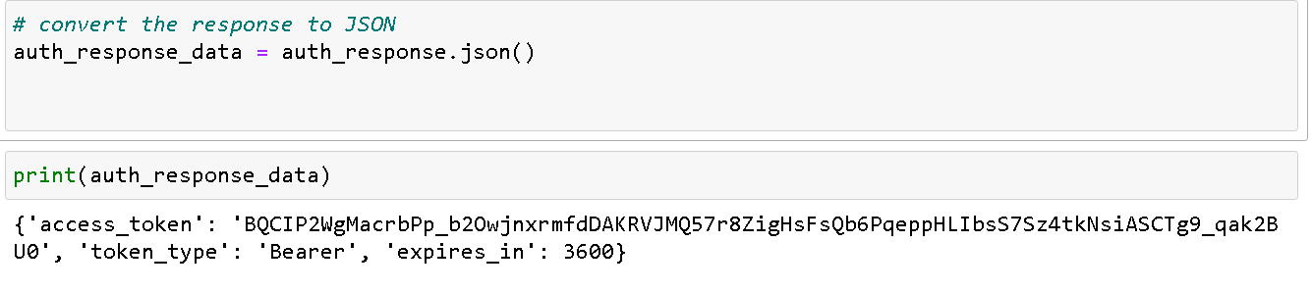
In Json format we can access the data we actually care about, the access token

Slide 39
We now have the access token. Now what can we do?
We can now make request to the API. We did all this work getting verified. Now we are in and can get our hands on some data (WooHoo)

Slide 40
Why do we need the api in the first place? What data do we want?
While the downloaded data does have some valuable data for us it is missing some key components.
For example, wouldn’t you want do visualizations based on the genres you listen to?
Of course you would!!
But that data isn’t in our data frame(at least not yet)

Slide 41
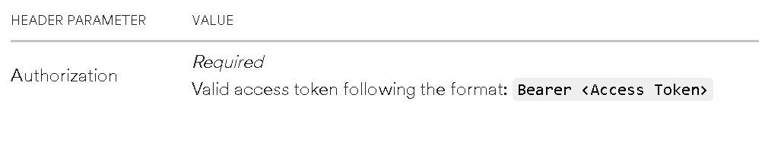
Now we can use the access token to get genres. How do we do this?
Well for using the access token we format it like such. This will be the standard

Slide 42
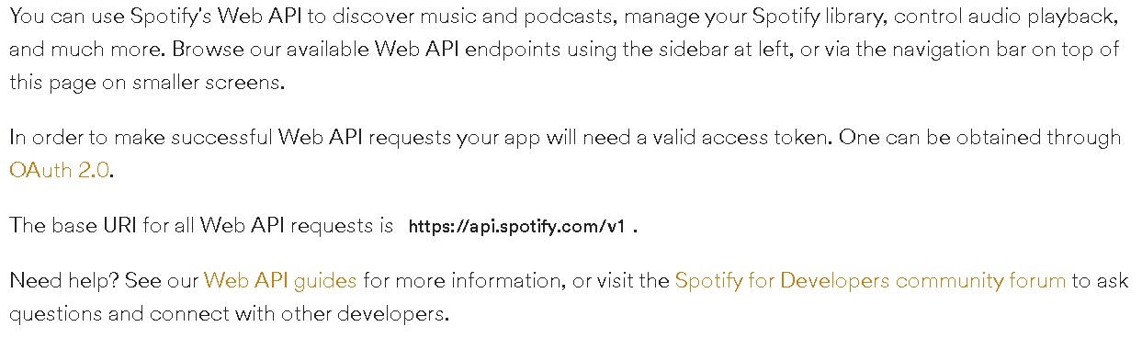
How do we go about getting data we are concerned about using the access token?
Luckily Spotify has data on this. Let’s investigate.

Slide 43
Endpoints
There are endpoints that are used at the at the end of the base url to retrieve data.
The type of endpoint depends on what data you want to know
We want to know about our genres
What endpoint should we use?
Let’s suppose we don’t know

Slide 44
How do we move forward?
We know that we have all our tracks and their track uris
We can use the track uris to get information about tracks and go from there
Perhaps we can get our genres from just looking at our tracks

Slide 45
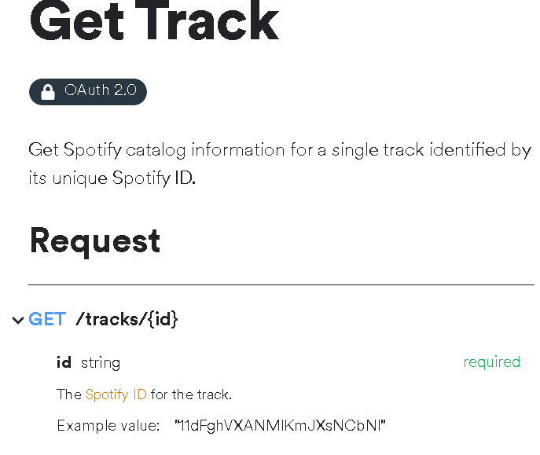
Endpoint we want to use is tracks
This is saying we use a get requests
We’ll use the access token to reach this endpoint
The endpoint for this case of the track would be as documented the base url/”tracks”/and the unique id for the track.
Let’s put it altogether!

Slide 46
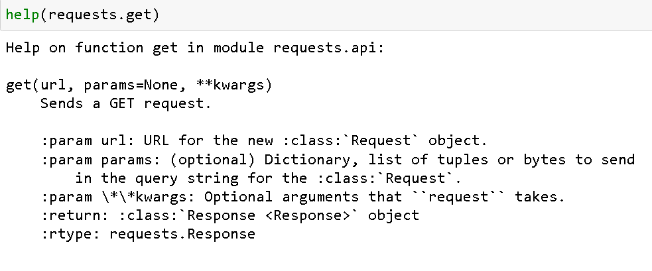
Deeper look at the get requests
We used request.post to actually enter the api
When it comes to using the to get data we use request.get
Let’s look at the function

Slide 47
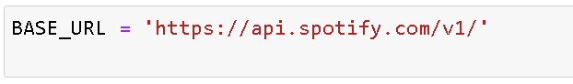
The url is the endpoint we’ll use with the base url to send and get data

Slide 48
The parameters
The params is just the header used for the access token
Putting it altogether

Slide 49
Let’s test it out
Something to note
The library data (songs we have liked) only has the track uri
The songs in our streaming history do not
Therefore we’ll only have genre information about data in your library, not your overall streaming data
Of course there’s a way to add tracks uris to every song but that’s for perhaps another workshop
For now we’ll let the songs you like indicate which genres you like and listen to
Sorry if you think the streaming data might be more indicative. It’s arguable for sure.

Slide 50
Lets get a random song from our data frame(library) and look up data based on the track_uri
Recall the tracks data frame we isolated from the library data
We’ll go back to the code to practice this
Notice this track has a track uri
This means we liked this track (it's in our library, well it's in mine it may not be in yours)
Since we have a track uri we can get information about it.

Slide 51
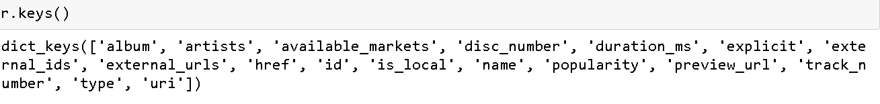
By sending our requests this happened
Sent the get requests using the track uri
We got a json file of certain components that are accessible to us now based on that track
If we look at the keys we see we have valuable information
Let’s look at the keys and see what we get

Slide 52
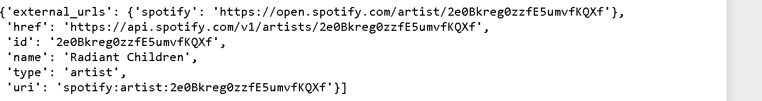
It seems we don’t have any noticeable info about the genre (darn it) but let’s look at some of the keys.
Let’s try artists
It doesn’t tell us the genres of the artist but we are provided the uri
What can do with this uri?
You guessed it we can make another api call with the artist uri and then perhaps we’ll get closer to getting genres

Slide 53
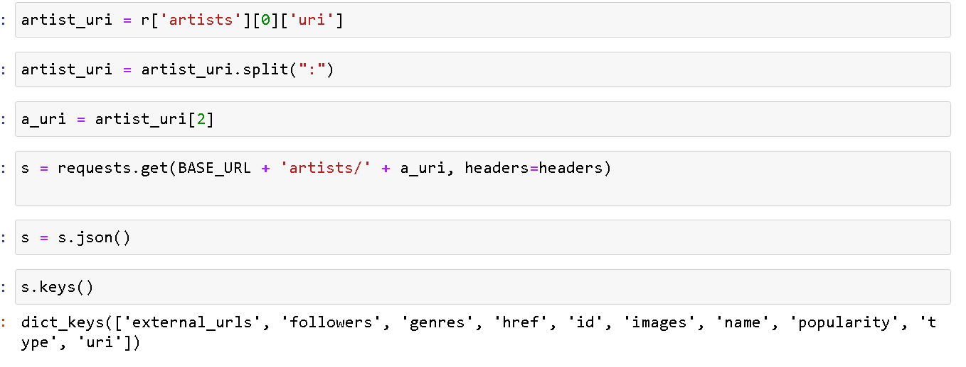
Lets send a request with the artist uri

Slide 54
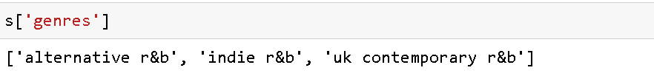
Now using the artist uri we can get actually get the genres

Slide 55
We now have a way to get the genres for every song in our library file
We just need to think of a way to do this for every single track in our data frame

Slide 56
Working with API’s (OAuth 2.0)
An API (Application Programming Interface) is a regulated software that allows two applications to interact with each other
1) Your very-smart application
2) The desired resource you’re looking for
HTTP Methods: GET, POST, CONNECT, ETC
Any param’s should be formatted as a dictionary
When to use POST (OAuth 2.0)
When the API requires a Client_ID and Client_Secret, we use a post request to exchange that for a OAuth2.0 token
We then specify our Authorization and Bearer in our headers value and pass that into any GET request
When to use GET (Public API)
When our API does not require an OAuth2.0
Those that don’t have sensitive customer data, or aren’t robust
https://random-d.uk/api
https://github.com/public-apis/public-apis

Slide 57
This is the most important takeaway that everyone has to remember.

Slide 58

Thanks!
Contact us:
Your Company
123 Your Street
Your City, ST 12345
no_reply@example.com
www.example.com

